Slide 1
Workshop 5 –creating effective partnerships
10th November 2022

Slide 2
Agenda
Stages of major projects – who to engage/partner with and when?
Complex partners and customers – how to address different stakeholder?

Slide 3
Objective
Introduce you to methods that can help you tackle partnering in major project opportunities
Consider complex partners and the roles within them

Slide 4
Stages of a major project – when are players involved – when do you engage?
Potential Partners | Stages of a major project
 | Origination | Design | Planning | Specification | Tendering | Construction
Developers
Engineering consultants
Planners (planning approvals)
Specification Consultants
Construction Company
Installers/Sub-contractors
Others?
If you are a major component – need to be involved here
If you are a smaller component – need to be involved here

Slide 5
Engagement/Partnering example: Core systems/component
Potential Partners | Stages of a major project
 | Origination | Design | Planning | Specification | Tendering | Construction
Developers | Are there developers with right mindset we should focus on?
Engineering consultants |  | Do we have contacts who will promote our approach? Are they brave enough to recommend us?
Planners (planning approvals) |  |  | Do planners need briefing on why our approach is best?
Specification Consultants |  |  |  | Do specifiers know of/like our technology Would they be brave enough to recommend it?
Construction Company |  |  |  |  | Are the tech people in big construction companies aware of us – will they push back at us being specified?
Installers/Sub-contractors |  |  |  |  |  | Are installers aware and positive Have we trained sufficient numbers?

Slide 6
Stages of a major project, potential partners, and when to engage them - tool
Potential Partners | Stages of a major project
 | Origination | Design | Planning | Specification | Tendering | Construction
Developers
Engineering consultants
Planners (planning approvals)
Specification Consultants
Construction Company
Installers/Sub-contractors
Others?

Slide 7
Exercise
Using the format to consider which partners you need (for a major project you are considering – or would like to be part of) and when to engage them
Will they support you being part of the programme?
How can you ensure this?

Slide 8
Agenda
Stages of major projects – who to engage/partner with and when?
Complex partners and customers – how to address different stakeholder?

Slide 9
Partnering with big complex organisations
Have you ever heard this said? (or have you said something like this?):
“We’re talking to Shell – they are really interested”
“Their R&D guy said they would love to see this included in their new development project”
“They said they would move fast on this”

Slide 10
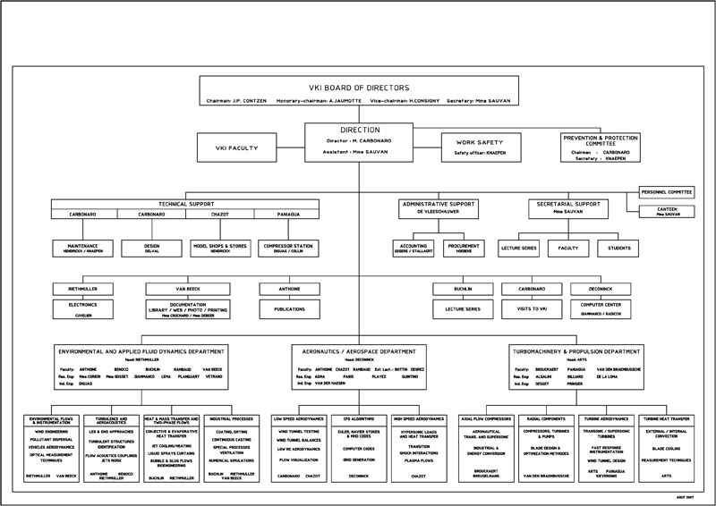
Know “who is who”
Blockers
Decision Makers
Influencers
There will be several people involved in decision making. You will need an internal champion.

Slide 11
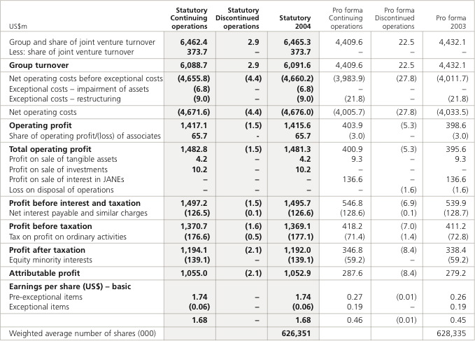
Understand the Operational Corporate Drivers
The corporate drivers will determine behaviour. Its critical to ensure your venture is clearly aligned with KPIs and divisional scorecard

Slide 12
Understanding the end user buying process and buying factors?
Buying processes:
Who are the decision makers, what’s the budget limit?
Buying factors:
Is your solution valued for cost reduction, performance improvement capacity expansion?
Impact:
What’s the level of impact on clients operation?
What’s the relative importance in the project hierarchy?
Other
Finance or purchase agreements, Warranties, installation & commissioning considerations, decision time frames, references.

Slide 13
Complex partners - made up of differing but influential different stakeholders
Often we think of business customers as if the are a single entity – “we made a sale to BP this week” – this is highly misleading
Business customers are typically complex – that is there are several people involved making a purchase decision – each with a distinct role
In this model there are four distinct roles within the business customer
Economic buyer – the person with the cheque book (often the boss of the user)
Technical buyer – the person who has to be satisfied that the goods are “fit for purpose”
User – the actual people using the products and services
Coach – a customer employee who is keen that your products are purchased and will help you to meet the right set of people – for major or difficult sales a coach is invaluable
Economic Buyer
User
Technical Buyer/ Evaluator
Coach
Components of a Complex Customer

Slide 14
Strategic Selling - Most business customers are “complex”- made up of differing but influential different buyers
Board
Economic Buyer
User
Gareth
James
James
Technical Buyer
Coach
Sarah
David
I like a different technology
Bob
Components of a Complex Customer

Slide 15
Complex partners - made up of differing but influential different stakeholders
Economic Buyer:
Key concerns:
How to get on-side?:
User:
Key concerns:
How to get on-side?:
Technical Buyer/Evaluator:
Key concerns:
How to get on-side?:
Coach:
Key concerns:
How to get on-side?:

Slide 16
Exercise
Using the format to consider who are the key stakeholders in the partner – what are the key concerns of each
How do we ensure each stakeholder is positive towards us?

Slide 17
Questions?

