Slide 1
Workshop 7 - Value prop, messaging and branding
15th November 2022

Slide 2
PREVIOUSLY COVERED…
14:00 | Intros & Ice breaker
14:10 | Psychological barriers to climate action
14:30 | Methods to understand your users
15:00 | BREAK
15:05 | Persona mapping
15:25 | User journey mapping
15:45 | Other research methods
15:50 | Next steps
Understanding your users
Nov 2nd
Marie Geneste
Marie@theccollective.com
Notes:
Recording permissio
Nat intro
Follwup up session and expectations

Slide 3
14:30 | Intros & Recap
14:40 | Value proposition per persona
15:10 | Developing brand messaging
15:40 | (re)Designing your brand
16:20 | Q&A - Close
Value prop, messaging and branding
Nov 15th
Marie Geneste
Marie@theccollective.com
Notes:
Recording permissio
Nat intro
Follwup up session and expectations

Slide 4
My background
CLT associate with 15y experience in international marketing, user experience and sales
Circular economy consultant
Worked with blue-chip and start-up organisations, B2B / B2C
Founded the C Collective to focus only on organisations with positive social and environment impact
marie@theccollective.com
Notes:
Marie > a few words…i’m here because i believe in the power of CX to mainstream sustainable products and services. I’m here because i want you to fight with the same tools or event weapons as the other businesses out there.

Slide 5
Introductions & expectations
Notes:
Before i take you through my presentation, it would be great to learn about everyone’s background and their expectations. So if you haven’t done so yet, please write your name and organisation and maybe some question/ expectation you have for today’s session.

Slide 6
Developing value propositions per persona

Slide 7
What is your strategic mission?
WHAT Every organization knows what they do, these are the products or services they sell/promote. HOW Some organisations know How they do it. These are the things that make them special, set them apart from competition. WHY Few organisations know why they do what they do. Why is the purpose, cause of belief. It’s the very reason your organization exists
Result
WHY
Process
HOW
WHAT
Purpose
Notes:
WHY
Single purpose, cause and belief that serves as driving and inspiring force for indiv as a founder or an organization.
HOW
Best written in verbs to reflect action, your Value prop or something really close.
WHAT
The tangible things your organization offers.

Slide 8
Example
WHY We believe mainstreaming a healthy, high-performance and zero-carbon built environment is key to tackle the climate emergency. HOW That’s we promote the NetZeroBuild standard which is the most energy efficient building standard thanks to its rigorous design and build approach, quality assurance and demonstrated performance. WHAT > Awareness and education campaigns for all built environment stakeholders – incl the public. > Support the training of designers and contractors of NetZeroBuild buildings. > Maintain the rigorous standard and certification process. Collect and communicate evidence of performance.
WHY
HOW
WHAT

Slide 9
Your strategic mission
TEMPLATE TO FILL
WHY
HOW
WHAT
Purpose
WHY
Process
HOW
Result
WHAT

Slide 10
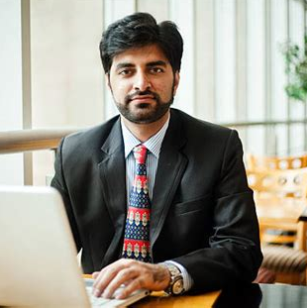
Value proposition per persona
The company….
helps social housing or public organisations’ building/estate managers
who want to build affordable, net zero ready building
by providing a tried and tested building framework that is the only UK standard fit to achieve net zero
and offers healthy, qualitative and sustainable buildings that are affordable to run.
helps Homeowners
who want to build beautiful, affordable, healthy, high quality and sustainable homes
by educating them on reliable sustainable building solutions
and allowing them to gain more understanding on how NetZeroBuild work, their benefits and connecting them with PH design & build experts

Slide 11
Value proposition per persona
Product
Persona
Notes:
VP: a short and simple description of how your product/service fulfil a customer need in a unique way (i.e. better than the competition). It is rather internal but can be leveraged to engage with external people too. Best to develop it for each of your main personas.

Slide 12
Value proposition per persona
Product
Persona

Slide 13
Value proposition per persona
My company….
helps -
who want –
by -
and -.
helps -
who want –
by -
and -.
TEMPLATE TO FILL
15 min

Slide 14
Product:
Persona:
Notes:
PRINT

Slide 15
Value proposition per persona
Xxxx helps -
who want –
by -
and -.
Xxxxx helps -
who want –
by -
and -.
Notes:
PRINT

Slide 16
Developing your brand messaging
Notes:
MARIE Now that we’re on the same page on what a brand is and why it is so important to invest in your impact brand, let’s dive into how to the process of designing or refreshing a brand

Slide 17
Developing a modular set of messaging
Strategic mission statement (WHY-HOW-WHAT)
Value proposition per persona
Key benefits and proof points, for each persona

Slide 18
Key messages for persona x
Muscle up all these claims with facts / proof points
Benefit 1 Xx | xxx
Benefit 2 X
Benefit 3 x
Benefit 4 x
Benefits of xx
Features / reason to believe
Notes:
Website copy on benefits
Financial • Increase revenues from higher net power generation • Reduce operating & maintenance costs (O&M) • Estimated 12-month breakeven for the client • Help access new revenues – reactive power, grid support, etc.
Risk Mitigation • Reduce costly unplanned outages/hasten restoration of generation • Ensure grid code and electricity offtake purchase contract compliance to avoid penalties
Operational Efficiency • Improve operational awareness, knowledge of asset condition, and anticipate equipment failure • Improve maintenance planning & operational reporting
Life Extension • Extend useful economic life • Defer replacement costs

Slide 19
Key messages EXAMPLE – per persona
Increased profit Reduce OPEX while maximizing power generation | Increase revenues from higher net power generation Reduce operating & maintenance costs (O&M) Extend useful economic life of equipment Estimated 12-month breakeven for the client Enabler of modern grid > Help access new revenues – reactive power, grid support, etc.
Mitigated risk Help anticipate and mitigate risks of failure and outage in your assets | Cutting edge hardware and software providing high resolution data (frequency- real time? Time stamped and type) allows to predict and detect component issues Ensure grid code and electricity offtake purchase contract compliance to avoid penalties
Better operational efficiency Helps plan maintenance and calibrate equipment to optimise performance | High-resolution condition monitoring allows to plan maintenance, send alerts when a problem is detected and tune solar farm’s high-voltage “power-train” of inverter-transformer-switchgear for optimal performance Visual dashboard allow easier maintenance planning and overall reporting
Reliability and security You can rely on our built to last, secure hardware and data platform. | Hardware: powerful & sturdy unit combining high-end monitoring equipments. Add proof of reliability / maintenance Dataware: robust and scalable platform which can handle the huge amount of high resolution big data collected. Add on security.
Benefits of xxx
Features / reason to believe
Notes:
Website copy on benefits
Financial • Increase revenues from higher net power generation • Reduce operating & maintenance costs (O&M) • Estimated 12-month breakeven for the client • Help access new revenues – reactive power, grid support, etc.
Risk Mitigation • Reduce costly unplanned outages/hasten restoration of generation • Ensure grid code and electricity offtake purchase contract compliance to avoid penalties
Operational Efficiency • Improve operational awareness, knowledge of asset condition, and anticipate equipment failure • Improve maintenance planning & operational reporting
Life Extension • Extend useful economic life • Defer replacement costs

Slide 20
Key messages for persona x
Template to fill
Muscle up all these claims with facts / proof points
Hero
Benefit 1 xx | xxx
Benefit 2 x
Benefit 3 x
Benefit 4 x
Benefits of xx
Features / reason to believe
Notes:
Website copy on benefits
Financial • Increase revenues from higher net power generation • Reduce operating & maintenance costs (O&M) • Estimated 12-month breakeven for the client • Help access new revenues – reactive power, grid support, etc.
Risk Mitigation • Reduce costly unplanned outages/hasten restoration of generation • Ensure grid code and electricity offtake purchase contract compliance to avoid penalties
Operational Efficiency • Improve operational awareness, knowledge of asset condition, and anticipate equipment failure • Improve maintenance planning & operational reporting
Life Extension • Extend useful economic life • Defer replacement costs

Slide 21
Build a content matrix and editorial calendar
Key messages | Target personas | Sector | Journey stage | Content name | Catchy headline story | Short form | Long form | Crosslinked content
PH Sustainable / net zero solution | Estate manager | Education | Awareness | Achieving net zero in education built environment | How to achieve net zero in the education built environment? | Exec summary blog, infographic, checklist | Article, Research whitepaper, Webinar/Tutorial | 5 award winning sustainable education buildings (newsletter with PH article)
Affordable to build and run | Estate manager | Education, Social housing | Choice | Understanding the long-term cost/ benefits of PH in public buildings | PH extra building costs are expected to decrease from +8% to +4% | Exec summary blog, infographic | Research report (updated 2020?), Webinar/Tutorial | Building a business case for a PH building
….
Action: Build your content matrix using this TEMPLATE with existing and new content to produce, prioritise into a content calendar and keep time for content production and set up a monthly editorial committee

Slide 22
Think about engaging content along the buying journey and across channels
PERSONA:
xx
Raise interest and attract
Engage
Nurture
Qualify
Get referrals
Convert
Delight
CLIENT
CHANNELS
Notes:
Helicopter view of the buying journey of your persona across all relevant channels / touch points
It really helps you identify in a holistic and resource efficient way what you need to do all across the business to attract users and then convert them into happy customers.
Helps people in you organization put themselves in the shoes of the users and also acknowledge that Love at first sight hardly ever happens. For simple tech products categories such as Laptops/TV, takes approx. 3 touchpoints before the sales and for complex tech/services 10-12 touchpoints.
This is why understanding and mapping this will be the cornerstone of your experience and marketing strategy.

Slide 23
My content calendar
PERSONA:
xx
Raise interest and attract
Engage
Nurture
Qualify
Get referrals
Convert
Delight
CLIENT
CHANNELS
Notes:
Helicopter view of the buying journey of your persona across all relevant channels / touch points
It really helps you identify in a holistic and resource efficient way what you need to do all across the business to attract users and then convert them into happy customers.
Helps people in you organization put themselves in the shoes of the users and also acknowledge that Love at first sight hardly ever happens. For simple tech products categories such as Laptops/TV, takes approx. 3 touchpoints before the sales and for complex tech/services 10-12 touchpoints.
This is why understanding and mapping this will be the cornerstone of your experience and marketing strategy.

Slide 24
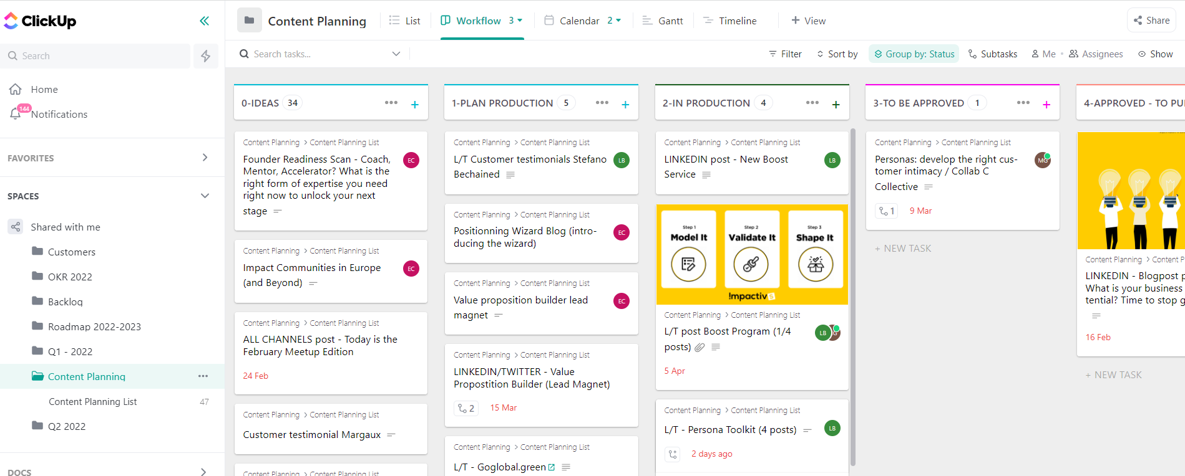
Tip > Organise content production with a PM tool with calendar/gant views (Hootsuite, Click up, Asana, Monday…)

Slide 25
What is an impact brand?

Slide 26
Branding is about Shaping a personality for your organisation
Brand = intangible assets which help people shape their perception of the organization, its products or services.
When you add the impact dimension, it’s even more important to craft and convey a personality which is genuine, charismatic and engaging.
Notes:
Marie
A simple definition of a Brand could be the concepts, intangible assets, which help people shape their perception of the organization, its products or services.
Essentially, branding is about shaping a distinctive identity, a special personality for an organization, so that its target audience will want to bring it into their life.
When you add the social and environmental impact dimension, it’s even more important to craft and convey a personality which is genuine, charismatic and engaging.
In the sustainability space, overpromising in terms of branding and underdelivering in terms of impact is just greenwashing.
Likewise having a positive, measurable social and environmental impact with a bland or inelegant brand is also a missed opportunity.
SO The key in impact branding it to accurately define your impact, define how you want your audiences to perceive you and thoughtfully design your brand to align perception and reality.

Slide 27
Aligning Impact & branding
Branding > Impact = Greenwashing
Branding < Impact = Missed opportunity
Notes:
Marie
In the sustainability space, overpromising in terms of branding and underdelivering in terms of impact is just greenwashing.
Likewise having a positive, measurable social and environmental impact with a bland, dull or outdated brand is also a missed opportunity.
SO The key in impact branding it to accurately define your impact, define how you want your audiences to perceive you and thoughtfully design your brand to align perception and reality, so that your branding really serves your impact.

Slide 28
The evolution of branding
Notes:
FIONA

Slide 29
“A great brand is a story that’s never completely told. A metaphorical story that connects with something very deep – a fundamental appreciation of mythology. Stories create the emotional context people need to locate themselves in a larger experience.” Scott Bedbury
Notes:
FIONA Brand is such an important part of the end to end user experience

Slide 30
Does Your branding work hard enough for your purpose? Is it time to refresh It?
USER FEEDBACK
Ask feedback about your brand from people in your audience
BUSINESS PLAN ALIGNMENT
Look at what changed since your original business plan
Have you explored new audiences & markets?
Is your brand still in line with your future plans?
CULTURE & VALUES
Have your culture and values evolved?
MARKET & TRENDS
What is competition doing?
It is enough unique and inspiring to reflect your impact?
Logo styles and colour palettes also go out of fashion
Notes:
MARIE

Slide 31
BRAND Feedback
For each brand let’s add 3 words on each brand

Slide 32
The bullet proof brand design process
Notes:
MARIE Now that we’re on the same page on what a brand is and why it is so important to invest in your impact brand, let’s dive into how to the process of designing or refreshing a brand

Slide 33
The (bullet proof) brand design process
resource efficient, saving time and money
based on actual science and theories
human centred
Includes user testing to derisk the process
Notes:
MARIE
This is a tried and tested process we have used with many brands, we call it bullet proof because in a way that is resource efficient, based on actual science / theories and most importantly human centred, because we put ourselves in the shoes of the users and create a brand personality that they ‘ll want to hang out with
and includes user testing to remove the risk of creating a brand which does not connect with your audience

Slide 34
The brand design process
STRATEGY
DESIGN
TEST
BUILD
Mission, user research, value prop
Brand personality
Naming
Moodboards
Creative routes
Testing routes with real users
Brand guidelines
Brand assets development
Notes:
MARIE

Slide 35
Strategy
STRATEGY
DESIGN
TEST
BUILD
Notes:
MARIE

Slide 36
Strategic foundations
Mission statement
Personas’ needs and pain points
Social and environmental impact
Value proposition
Notes:
MARIE

Slide 37
Defining your brand personality and values
Ambitious
Approachable
Aspirational
Authenticity
Attention to detail
Bold
Comforting
Committed
Community
Communicative
Compelling
Creative
Dependable
Disciplined
Disruptive
Effervescent
Ethereal
Efficient
Exclusivity
Evocative
Forward thinking
Fun / Youthful
Hedonistic
Imaginative
Intuitive
Independence
Innovation
Inspirational
Integrity
Logical
Luxury
Market Leader
Nostalgic
Nurturing
Optimistic
Organic
Passionate
Perceptive
Perfectionist
Personable
Pragmatic
Quick thinking
Reliable
Realistic
Sensitive
Simple
Strong
Timeless
Visionary
Welcoming
Warm
ACTIVITY
Select 5 to 6 traits or values which best represent your organisation, what your brand stands for, how you want it to be remembered?
Notes:
FIONA

Slide 38
Defining your brand personality
The 12 Brand archetypes
Originally designed by the Swiss Psychologist Carl Jung to help us understand human personalities at a higher level.
Each archetypes has a specific set of characteristics which can be used to define your brand personality.
A brand is often a hybrid of 2 archetypes
How to use them
A great tool to humanize the brand design process.
Go through the 12 archetypes and write down the attributes which draw you towards the archetype
Choose 1 or 2 archetypes
Notes:
MARIE
Originally designed by the Swiss Psychologist Carl Jung to help us understand human personalities at a higher level.
Each archetypes has a specific set of characteristics which can be used to define your brand personality.
Then adapted into 12 branding archetypes.
Also very imporant to create story for other stakeholders/ staff/ partners

Slide 39
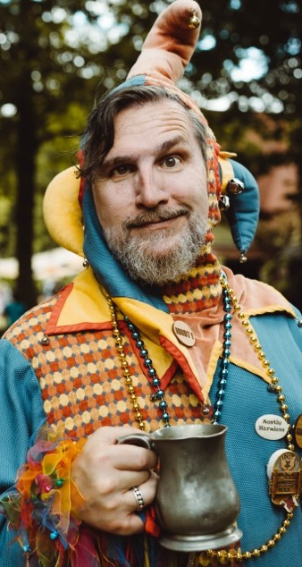
Hero
Magician
Outlaw
Lover
Everyman
Jester
Bravery, Strength
Make the world a better place
Stands up for the weak
Wants to change the world
Visionary - dreamer - idealist
Potential disconnect from reality
Rebel
Attracts outcasts in society
Wants to break the rules
Intimacy, desire
Passion, Indulgence,
Wants to convey raw emotion
Empathetic - Sense of belonging
The ‘person next door'
Authentic - Friendly
Enjoys life
Brings positivity to customers
Humorous and playful
Ruler
Caregiver
Creator
Explorer
Sage
Innocent
Wants power and control
Stability and security
Very organised
Authoritative
Caring and protective nature
Extremely generous
Makes people feel secure
Creative
Innovative, Daring, Inspirational
Focuses on experimentation
Pioneer in his field
Wants challenges and new experiences
Takes risks
Knowledgeable
Wise
Wants to teach others
Carefree, dreamer
Optimistic for the future
Trustworthy and reliable
Notes:
MARIE

Slide 40
Hero
Hero
Magician
Outlaw
Lover
Everyman
Jester
Define your archetypes (1 primary, 1 or 2 secondary ones)
Bravery, Strength
Make the world a better place
Stands up for the weak
Wants to change the world
Visionary - dreamer - idealist
Potential disconnect from reality
Rebel
Attracts outcasts in society
Wants to break the rules
Intimacy, desire
Passion, Indulgence,
Wants to convey raw emotion
Empathetic - Sense of belonging
The ‘person next door'
Authentic - Friendly
Enjoys life
Brings positivity to customers
Humorous and playful
Ruler
Caregiver
Creator
Explorer
Sage
Innocent
Wants power and control
Stability and security
Very organised
Authoritative
Caring and protective nature
Extremely generous
Makes people feel secure
Creative
Innovative, Daring, Inspirational
Focuses on experimentation
Pioneer in his field
Wants challenges and new experiences
Takes risks
Knowledgeable
Wise
Wants to teach others
Carefree, dreamer
Optimistic for the future
Trustworthy and reliable
Notes:
MARIE

Slide 41
Tone of voice
How your brand communicates with the audience and thus influences how people perceive your messaging.
Includes the choice of words, communication style and emotional tone
How you want to communicate to your audience, rather than what.

Slide 42
Tone of voice
> Bring to life your brand personality into words
> Allow different sources to produce consistent content across channels
 | Description | Do | Don’t
Superior quality. | High-end tech, high resolution data, both in terms of exhaustivity and precision, real-time. Secure, reliable, science/data based, trusted Rolex / Tesla type | Bold statements Factual – evidence based statement User testimonials More content on reliability/ data security FAQ Quality pictures Accreditations / analyst reviews | Patronising tone
Disruptive. | Forward thinking Disrupting the status quo in a rules driven industry Bold | Strong Mission statement Before / after – Problem / solution statements | Vague claims
Empowering. | Eye-opening data with actionable insight Allows asset owners to be ahead of the game and maximize efficiency/profit Enabling the transformation of the energy sector and climate change mitigation | Interactive demo dashboards Examples of data and related use cases User testimonials / quotes
Approachable. | A high-end complex tech that can be explained simply into tangible benefits Insightful and actionable data for end users (dashboards, use cases…) | Use simple, though precise language, not too formal Simplify complexity by unravelling information into levels of technicality Use icons and visual material Examples, data, dashboards Glossary | Too much text Too much tech language at high level.
Notes:
Bring to life your brand personality into words
Allow different sources to produce consistent content across channels.

Slide 43
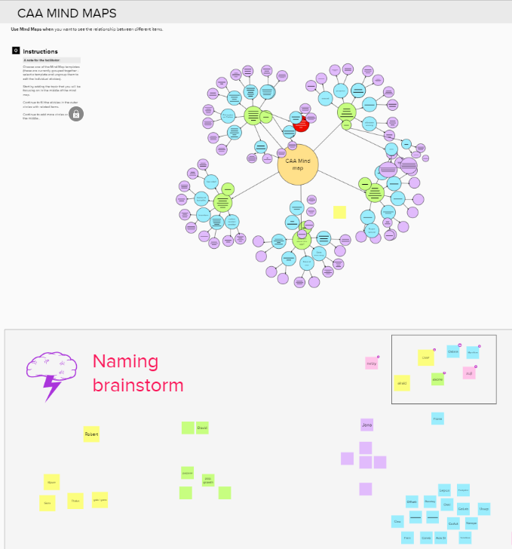
Finding a name
Brainstorm with a few creative people
Mind mapping
Naming brainstorm
Select some, check availability
Test with real people
Notes:
MARIE
Names forms an integral part of your brand
If you don’t already have or want to potentially evolve the one you have to better reflect your mission and purpose, it;s worth investing time in creating one.
It’s like for a baby, you want to get it right because once you have it, it;s not easy to change it.
A very efficient way to find a name
Now that we have all the strategic foundations in place and a good name, we can come to the design stage.

Slide 44
design
STRATEGY
DESIGN
TEST
BUILD

Slide 45
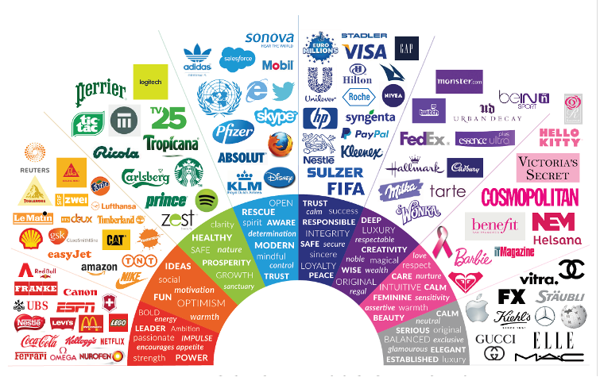
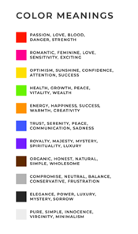
The colour theory
Notes:
FIONA
Now we are going to explore how we translate your strategic, values and personality attributes inputs into visual brand outcomes, starting with the colour theory
1st is to associate the words used to describe your brand values to colours, like in the above figure.
Start with a single colour which conveys your most important brand personality trait. For instance, if your brand has to do with healthy food, green would be a good primary colour choice. One or two secondary/complimentary colours can be added to contrast or complement one another.

Slide 46
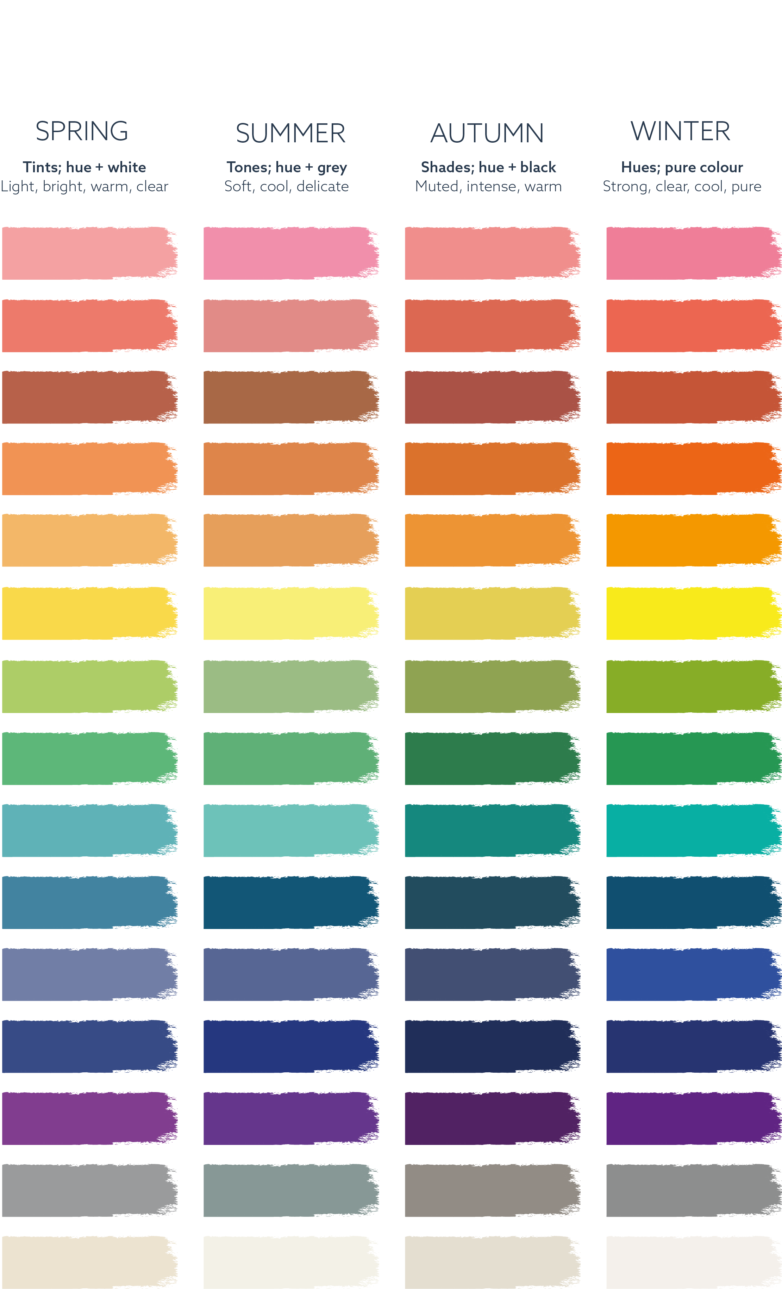
SEASONAL COLOUR PALETTE
Notes:
Once a primary colour is selected, you then refer back to your brand personality to identify which seasonal palette to select your colours from.
For instance, your primary colour may be green, but if you wish to convey feelings of confidence and luxury, a winter colour palette would be good - forest or hunter green, for example, would best represent your brand.
Likewise if the business was focused on being organic or natural the colour palette should be drawn from the warmth of Autumn - a sage green would work really well.
Youthful, forward thinking and approachable personalities are best represented by the bright, light tints of Spring, the best green for these brands would be lime or pistachio or if the brand needed to emulate beauty, aspiration or intuition the Summer palette should be used with cool but delicate tints like teal or aquamarine.
This theory can be applied to any colour throughout each season and can be contrasted with colours within the same season or across the seasons should the personality sit between two seasons.

Slide 47
Connecting brand values to a colour palette
Points:
Ambitious
Approachable
Aspirational
Authenticity
Attention to detail
Bold
Comforting
Committed
Community
Communicative
Compelling
Creative
Dependable
Disciplined
Disruptive
Effervescent
Ethereal
Efficient
Exclusivity
Evocative
Forward thinking
Fun / Youthful
Hedonistic
Imaginative
Intuitive
Independence
Innovation
Inspirational
Integrity
Logical
Luxury
Market Leader
Nostalgic
Nurturing
Optimistic
Organic
Passionate
Perceptive
Perfectionist
Personable
Pragmatic
Quick thinking
Reliable
Realistic
Sensitive
Simple
Strong
Timeless
Visionary
Welcoming
Warm
Notes:
FIONA

Slide 48
Logo structure & elements
Sequence of cognition

Slide 49
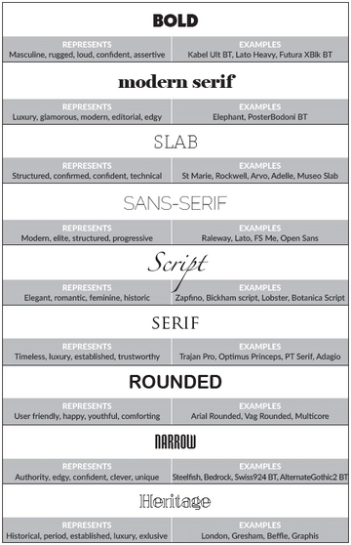
Typography
Notes:
FIONA
Typography and the use of fonts as word marks should also be carefully considered when developing a visual language. Light, wide space sans serif fonts are associated with modern, high end, trendy brands. Chunky, serif fonts are associated with exclusive, trustworthy, and established brands.
Once a brand personality is defined, the voice that comes from typography should be selected carefully to establish an immediate connection with the target audience through touchpoints such as your logo, content, or website. The below table shows how different fonts communicate a variety of brand personalities.
When choosing a font for a logo, it is worth looking at all the alphabet in its entirety to ensure it is compatible for multiple uses, ie. sub-branding or categorising, advertising, and signage etc. When selecting a font for use across brand collaterals, separate print and digital fonts should be chosen.
A Google font should always be used when choosing a digital typeface, this is to avoid font corruption through differing browser programmes, not to mention compatibility with Google will also ensure better Search Engine Optimisation (SEO).

Slide 50
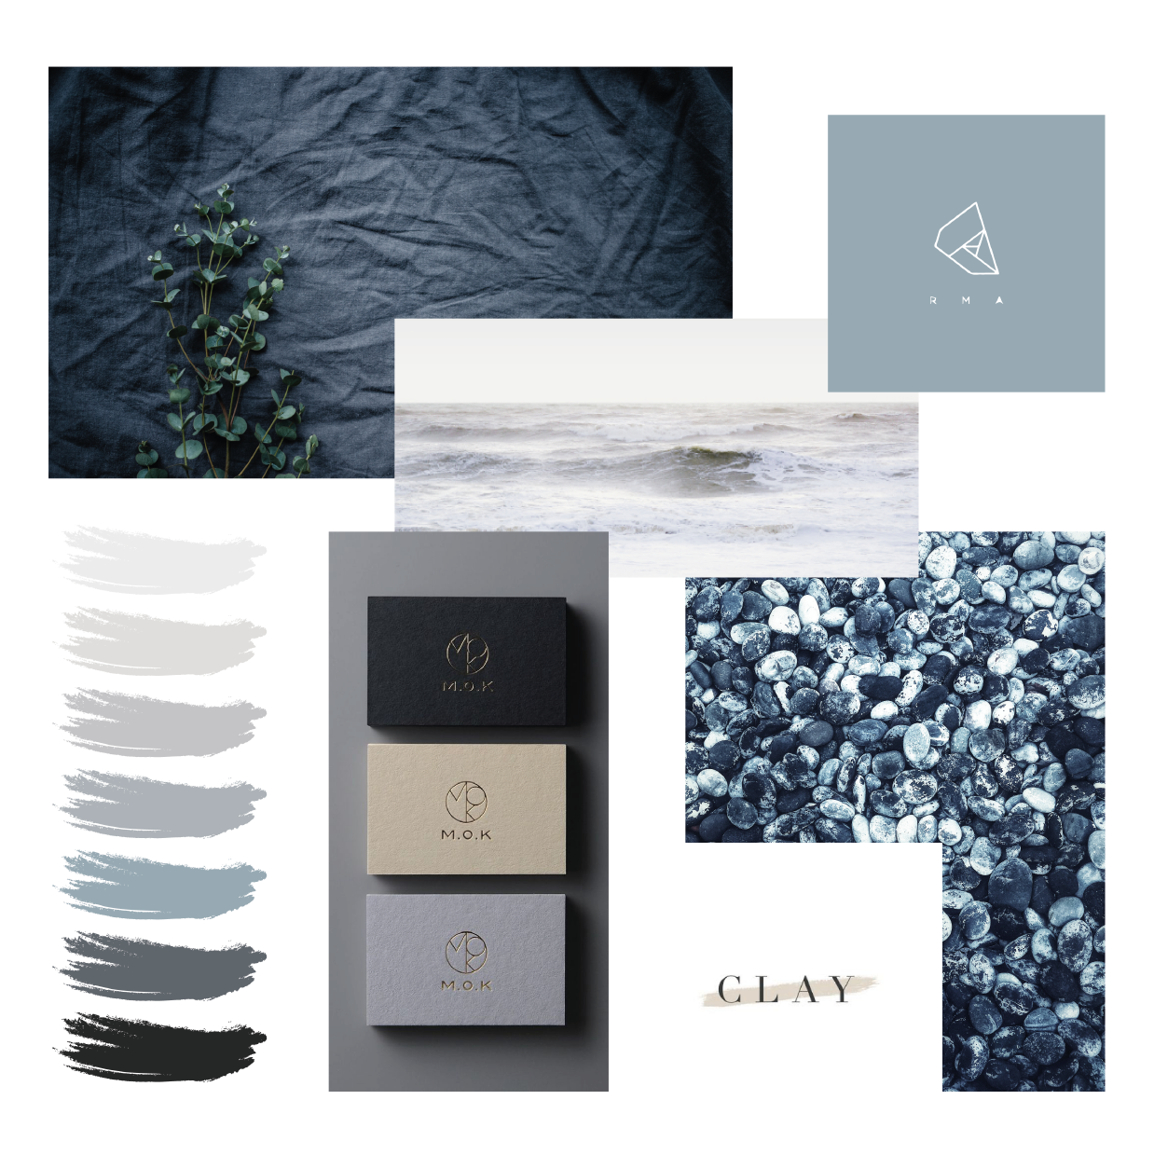
Imagery, icons & graphics
Notes:
FIONA
Identifying a graphic, icon and image style is important in conveying the right brand image. If the business is tech based for example, it would make little sense to use sketchy, hand drawn graphics and icons, however these would work really well for artisan businesses or events companies.
Quirky businesses wanting to stand out might use a style that echoes their individualism and character.
Photographic imagery doesn’t always have to be professionally taken and stock images are a cost effective and plentiful resource, however, be cautious when selecting images for your brand. Conceptual business imagery can really cheapen a brand, like using a light bulb for ideas or innovation, for example.
It is crucial to think more about the user experience- think less about what you are trying to tell your audience and more about you want them to feel. Is your brand aspirational or hedonistic? Then find imagery that matches these values. If in doubt, always return to your brand personality as this will help guide and remind you who you are speaking to and what you are trying to achieve.
Imagery can also be used to reinforce brand colours and an image selection can be made to continue this theme. This works especially well for marketing.

Slide 51
Typical Brand Design stages
Moodboard 1
Creative route 1
Moodboard 2
Final creative route implementation
Creative route 2
Testing
Moodboard 3
Creative route 3
Moodboard 4
Notes:
FIONA
We can help at any stage of the design process

Slide 52
Mood boards
Notes:
FIONA

Slide 53
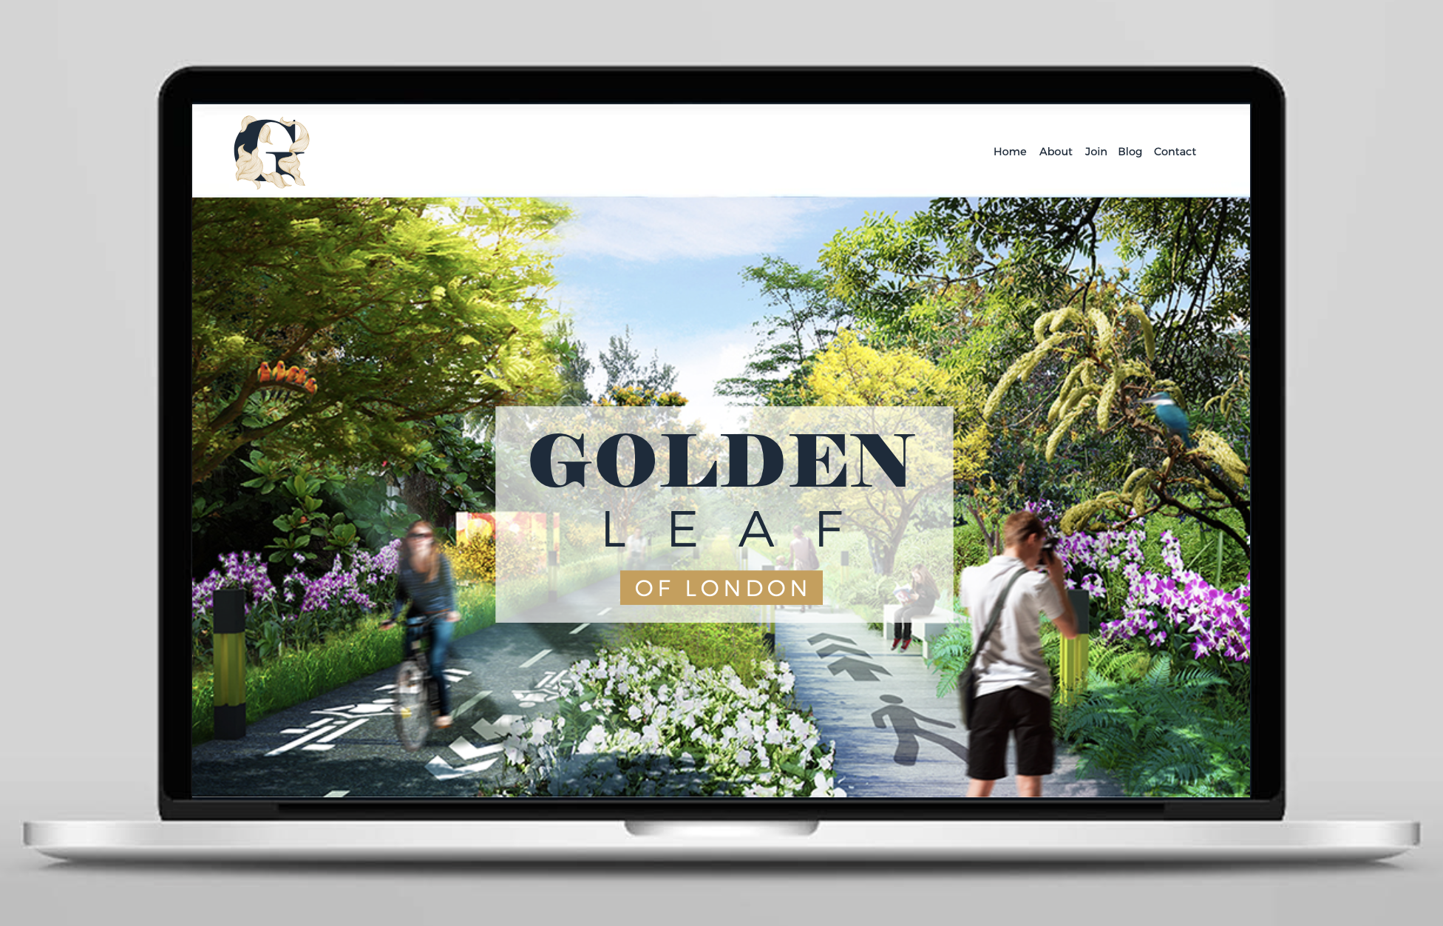
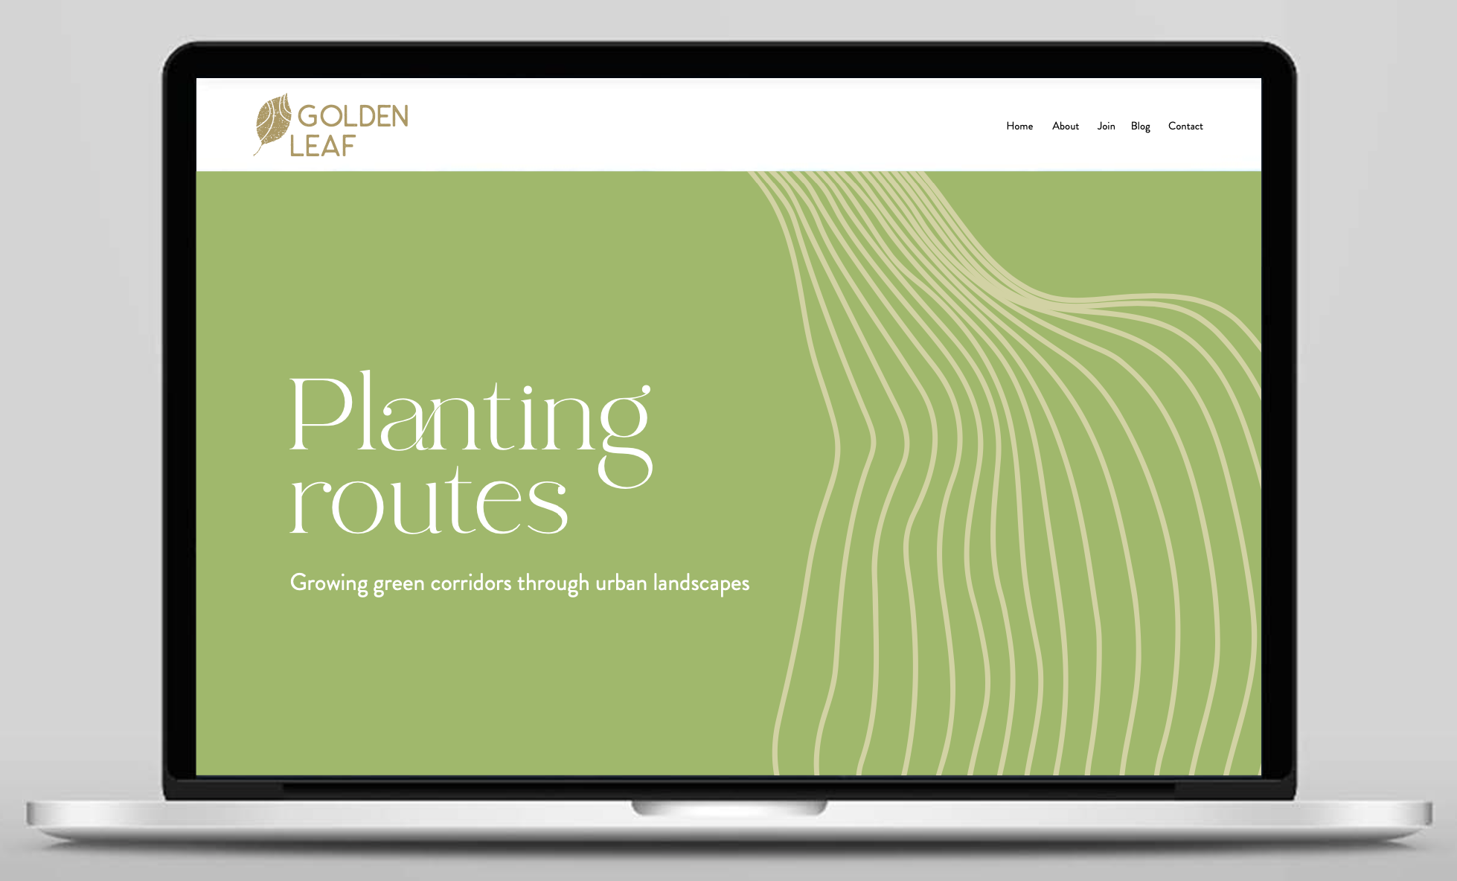
Creative routes
Notes:
FIONA

Slide 54
TEST
STRATEGY
DESIGN
TEST
BUILD

Slide 55
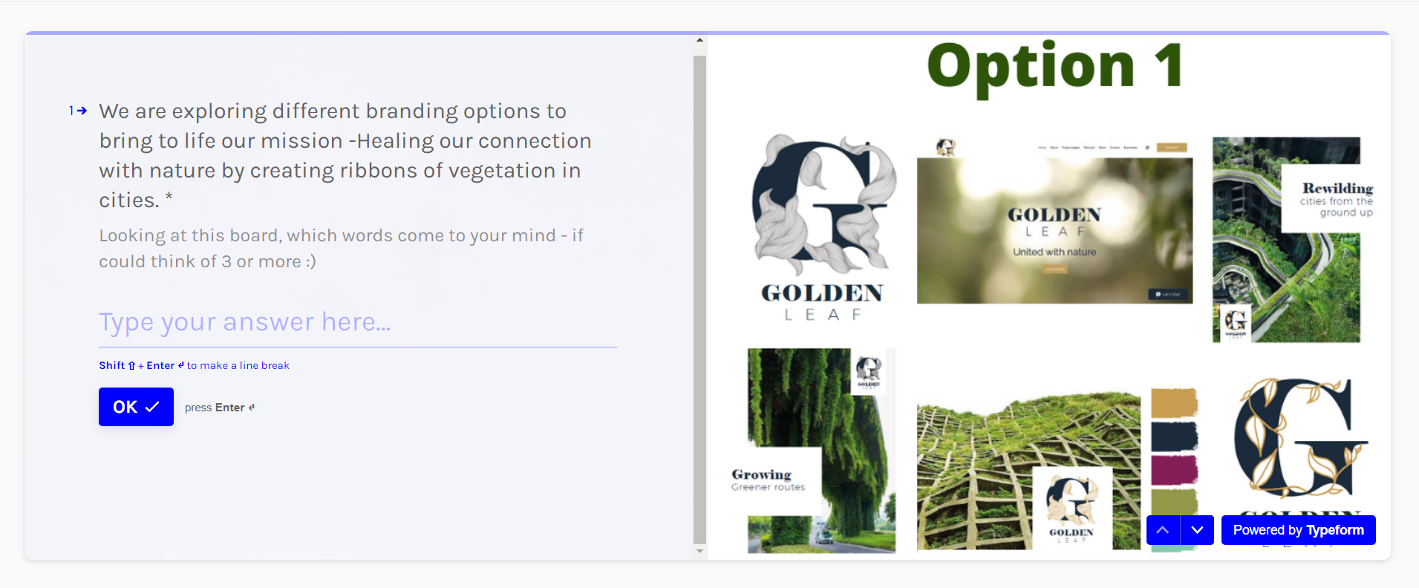
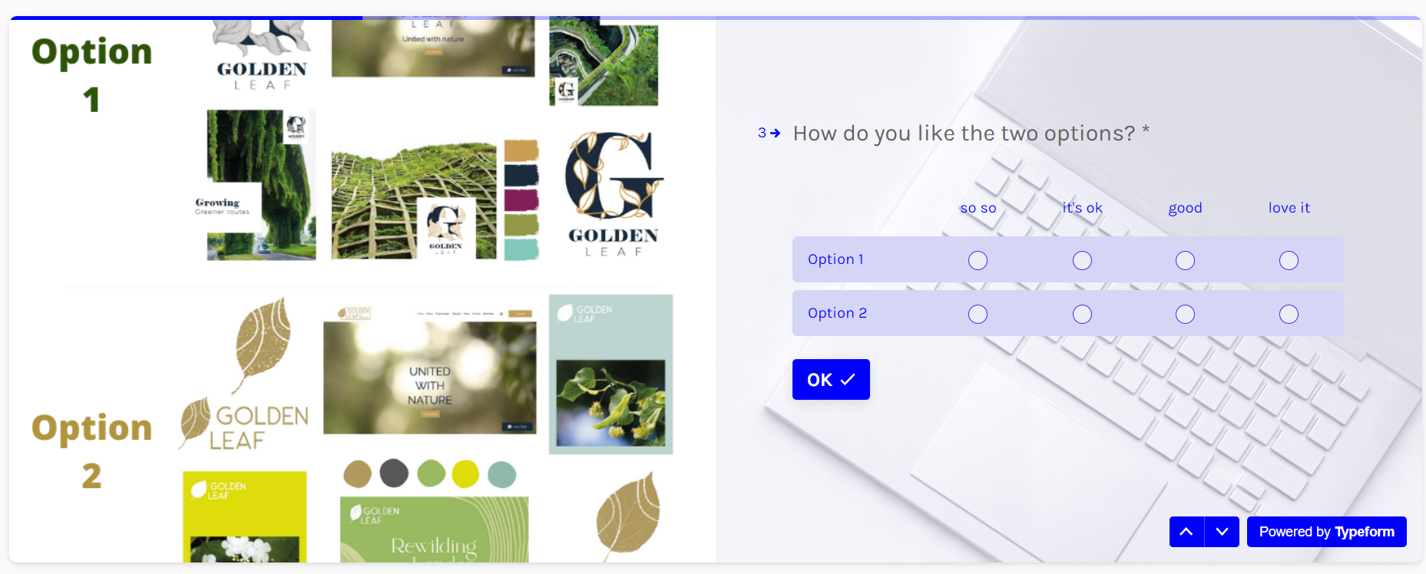
TESTING, most important step in the user centred design process
Best way to remove the subjectivity in the process, design something that works for your audience, move fast and derisk your branding investment
Notes:
MARIE
Did a couple of rounds of testing on 2 creative routes to collect some qualitative feedback and preferences.
Tested with about 30-40 people fitting the target audience.

Slide 56
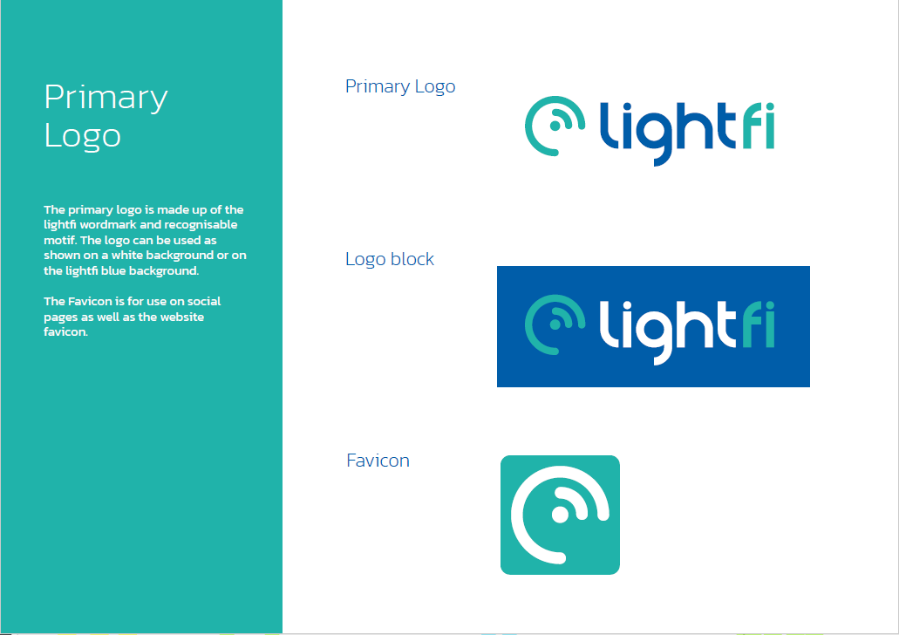
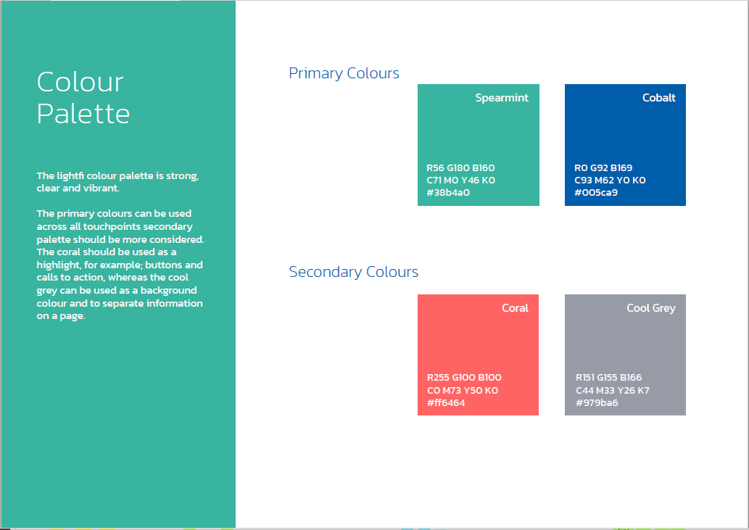
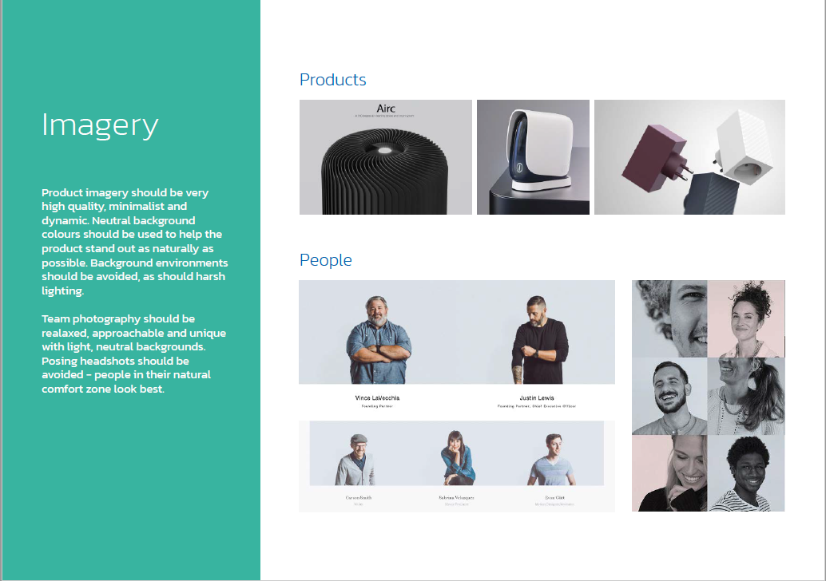
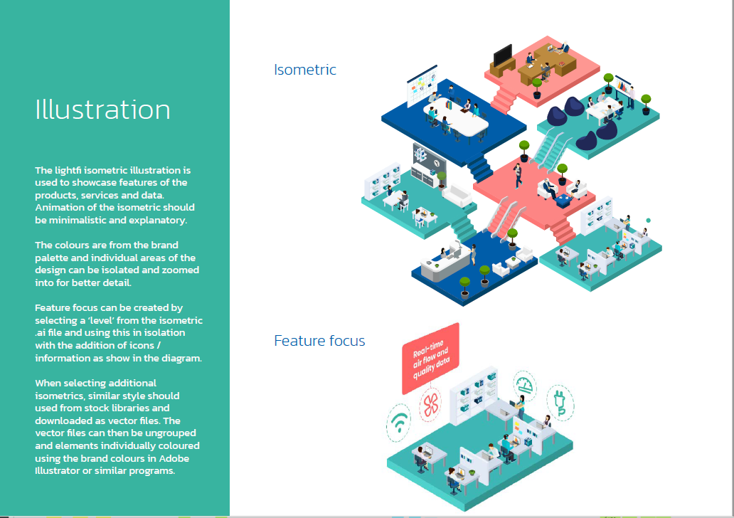
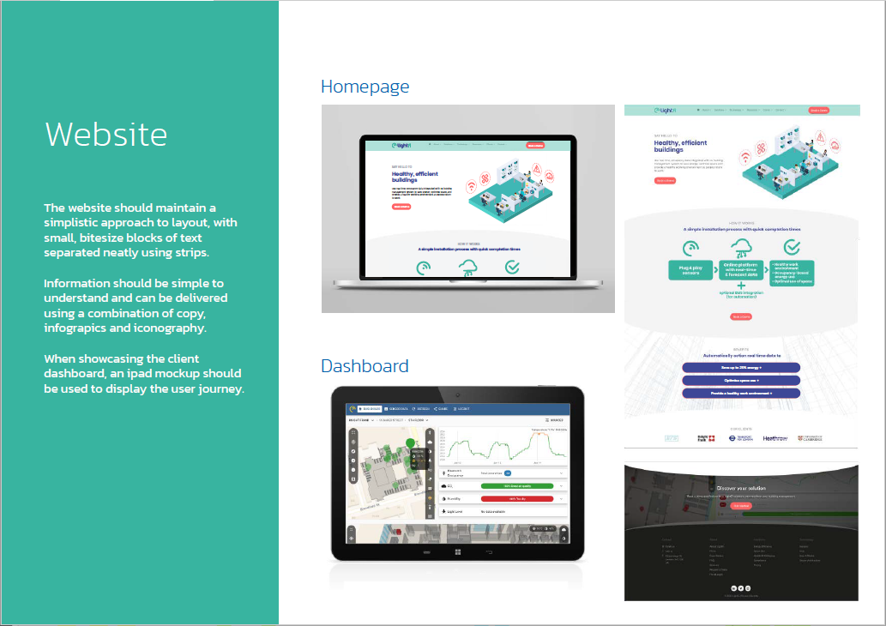
The output > Brand BOOK
Logo set for use in print, digital and social
A colour palette including primary and secondary colours
Typography guidelines with a choice of two or three fonts and a suggestion for hierarchy of use
A selection of images, icons, illustrations with guidelines on further imagery style and sourcing
Tone of voice guidelines
Notes:
MARIE

Slide 57
BUILD
STRATEGY
DESIGN
TEST
BUILD
Notes:
MARIE
The build phase is really about applying your brand guidelines to all the assets and touchpoints of your brand, website, print, content, social media and other collaterals.
This means whatever is in the brand book will probably require some adaptation, and certainly require going back to the design and testing board.
So it’s important to identify the type of assets the brand will be adapated to before you start your project so the brand guidelines are adapted and you get a more accurate estimate of the time and cost to create all of them.

Slide 58
Costs & timings
Brand book
Brand assets
STRATEGY
DESIGN
TEST
BUILD
1 month
3-6 weeks
1 w per iteration
2-4 weeks
£3-7k
£3-8k, depending on visual assets needed
Notes:
Marie
Now let’s talk about what it takes to go through this process and deliver all this.
The answer is, in the case of a small start up, not so much.
Assuming the strategic elements are in place before branding start, we’re talking about….

Slide 59
DO’s
Explore different styles, incl outside of your industry
Keep the decision making team small
Test with real users
Trust the process
DON’Ts
Take it personnally to remove the subjectivity
If using distictinve fonts for your logo, don’t use it elsewhere
Dismiss until tested
Underestimate time/budget for iterations and build phase to develop brand assets
Notes:
FIONA

Slide 60
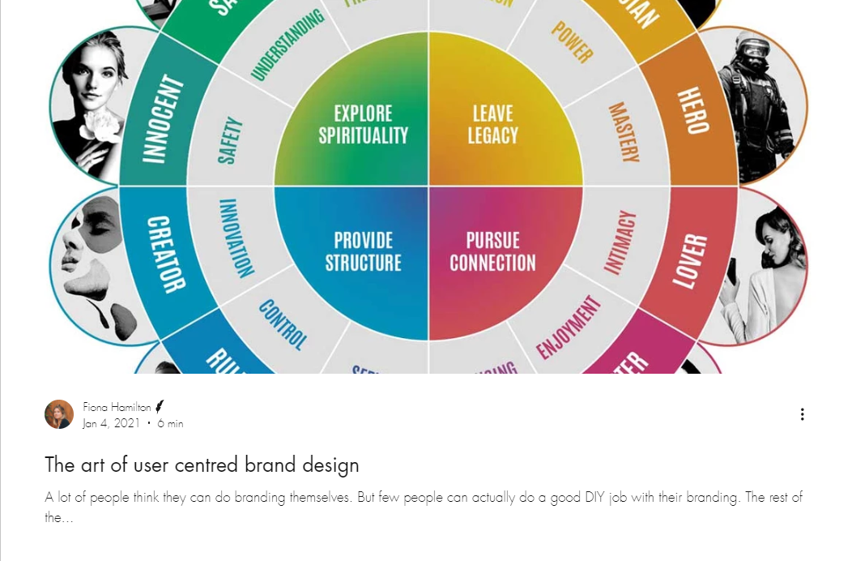
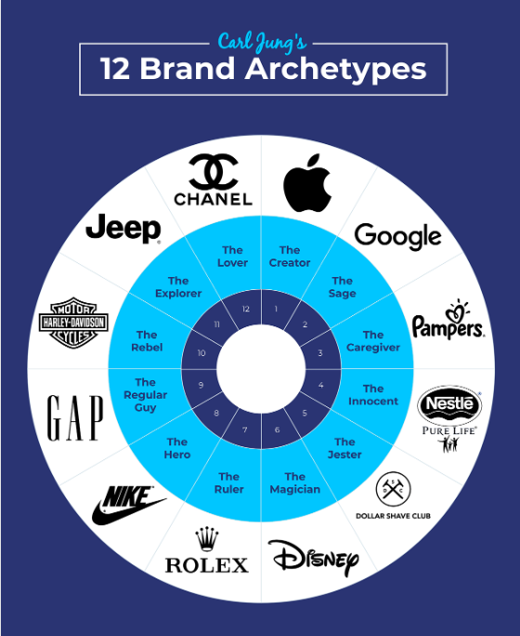
More info on branding
The art of user centred brand design
Carl Jung’s brand archetypes

Slide 61
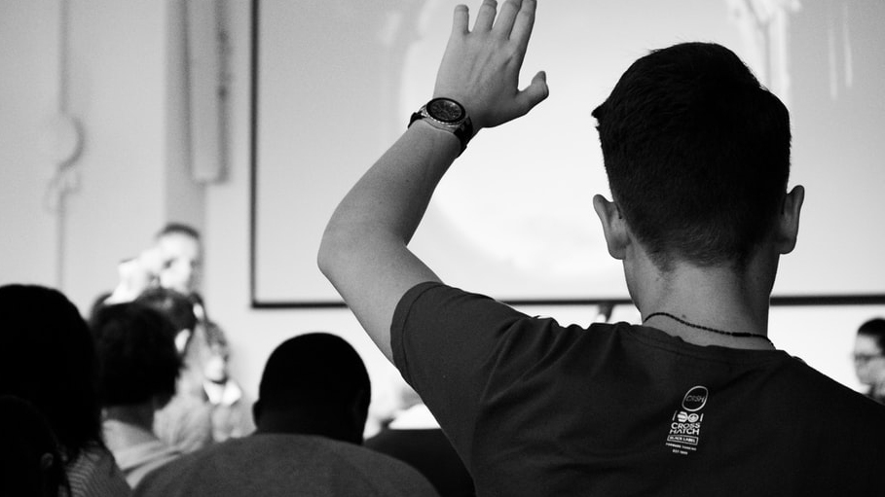
Q&A
Notes:
Check match expectations?
Next masterclass.

