Slide 1
Workshop 13 –building teams
13th December 2022

Slide 2
Growing pains – every company feels them
Characteristics From (past) To (future)
Revenue <£1m >£10m?
Staff <10 >50
Offices 1 50% WFH “20+ offices”
Countries 1 3
Product portfolio 1 3
Ouch!
A classic growth challenge – how do we build the team as we face an exponential rise in complexity?
Organisational challenges:
Used to know everyone personally
Relationships were able to substitute for process and formality
Shared value and trust – built up over many years held business together (but can no longer substitute for more formal mechanisms as scale increases)
Lot of tacit knowledge and know how – not written down

Slide 3
Self assessment
Commercial Readiness Leve | 1 Concept | 2 Seed | 3a Resource & plan | 3b Build | 3c Test | 3d Execute | 4a Market Entry | 4b Proven | 4c Growth
Market Understanding | Idea & basic market interest | Market research & engagement | CVP & route to mkt | Detail on chosen segment | Detailed competitor comparison | Pricing refinement | Customer feedback | Use feedback to create MK2 | International/other segment needs
Business Dev & Sales |  |  | Engagement | Lead gen for trials Engage channels | Select channel partners | Distrib agreements Full trials |  |  | International/New Segment plans
Strategy & Planning |  | First business plan | Synthesise all work streams | Synthesise all work streams | Synthesise all work streams | Second business plan | Budgeting/Regular finance |  | Growth strategy plan
Technology (TRL) | 3/4 | 4/5 | 5 | 6 | 7 | 8 | 8/9 | 9 | 9
IP |  | Preliminary filing | Investigate other IP needed | Freedom to operate
Product Dev | Concept dev | Prod Req’s | First prototype in line with mkt need | Improved prototype | Preliminary trial | Full trials | First commercial product | Refined product | New products for other segments
Supply Chain | Research | Engage | Requirements | First orders | Rework supply | Contracts | Operate SC | Grow volumes | New SC for scale
Team | Innovator | Innovator & PT/FT | Small FT team |  | Larger FT team (sales) | Marketing & Sales hires | Full company |  | Expansion team
Funding | Angel, grant, crowd | Angel, grant, crowd (Fund raising) | Grant, Private | Grant, Private | Grant, Private | Grant ,VC, Private (Fund raising) | VC, Private | Bank, VC, Private | Market, Bank, VC, Private

Slide 4
Example – how you might build up a team – what will be the right sequence for you? Not everyone has to be full-time from day 1
CRL | 1 Concept | 2 Seed | 3a Resource & plan | 3b Build | 3c Test | 3d Execute | 4a Market Entry | 4b Proven | 4c Growth
Chief technologist | x
Finance director |  | x
Sales/partnering lead |  |  | X (PT) |  |  | X (FT)
Product engineer |  | X (contract) |  | X (PT) | X (FT)
Marketeer |  |  |  |  |  | x
Chief Executive |  | x |  |  |  |  |  |  | X
Supply chain lead |  |  |  | x
Chair |  |  | x
Non-exec director |  |  |  | x
For larger businesses – replace this scale with time or revenue

Slide 5
Building our team - tool
Useful starting points for team build up:
What is the set of people and skills needed at our next funding point (and the one after that)?
Given our current team what is the next role we need?
Which roles can start part-time and then become full time?
CRL | 1 Concept | 2 Seed | 3a Resource & plan | 3b Build | 3c Test | 3d Execute | 4a Market Entry | 4b Proven | 4c Growth
Chief technologist
Finance director
Sales/partnering lead
Product engineer
Marketeer
Chief Executive
Supply chain lead
Chair
Non-exec director

Slide 6
Tackling growing pains – areas for discussion
Build processes – delegation is not a process (as it will come back to you) over time you will need:
Sales order handling/ Customer Service
Delivery, installation and maintenance
Order to cash
Hiring and review
Work force planning (schedules, timetables etc)
HR basics (payroll, holidays, sick leave)
Plan for specialisation
Smaller businesses have to have generalists
Bigger businesses can’t run with only generalists
Collect information digitally – boring, painstaking but crucial
Start in the cloud
Customer info and order management
Purchases
etc
Deliberately build the sort of ways or working and culture you want
It won’t happen automatically for newcomers (esp if they have worked elsewhere)

Slide 7
Hiring people full-time is only one way to access the skills you need (and often not the best)
Alternative to hiring
Try before you buy – capability and fit
Compare – don’t just assume that Jerome will be a great sales person because he was a good technician
Start with part-time people for certain roles (e.g. part-time finance director)
Use fixed term contract – which you can convert to employment
Use associates/freelancer – there is a bit market out there
Don’t assume a good early stage person is right for later stages – even in the same role
Risks of hiring
Costly (to recruit)
Slow and time consuming
Error rate can be high – which really matters in a small company

Slide 8
Instructions
Reflect on your stage of business development
What are the 1-2 biggest challenges in building up your team?
What currently is your solution?
We will go round each person and give feedback/comment

Slide 9
Questions?

Slide 10
Agenda
Gate manager roles – “Moments of truth”
Cost of Quality intro and pre-work
Selecting first customers

Slide 11
Gate managers and delegated responsibilities
Get a second hand one for £1

Slide 12
Agenda
Gate manager roles – “Moments of truth”
Cost of Quality intro and pre-work
Selecting first customers

Slide 13
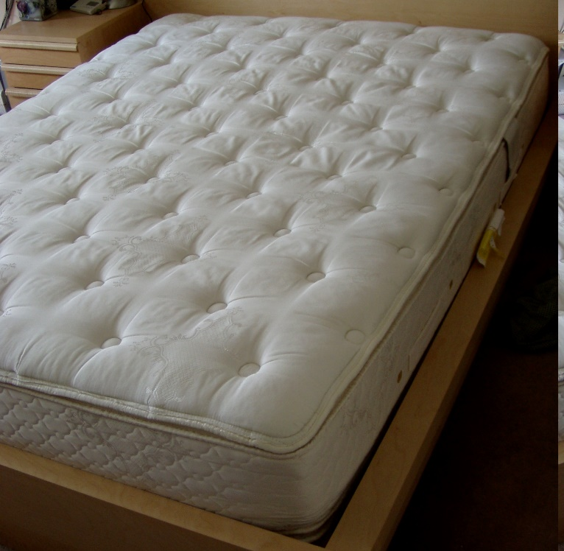
Cost of quality – a true story
Why is this a quality issue? Muda
Why are mattresses returned?
Why are mattresses returned? Too hard, too soft mainly?
What happens? – they get filthy in the van or in the warehouse when being returned
What are the costs
Cost of processing the refund
Wholesale cost of the mattress
Pick up cost
Warehousing & labour cost
Landfill/environmental disposal cost
Delivery of the next mattress………
“Almost all returned mattresses have to go to land fill/recycling”
Logistics Head – UK e-commerce business

Slide 14
“Muda” – Waste – the cornerstone of the quality movement
The 7 forms of muda (from the Toyota Production System – lean manufacturing):
Waste of overproduction (largest waste)
Waste of time on hand (waiting)
Waste of transportation
Waste of processing itself
Waste of stock at hand
Waste of movement
Waste of making defective products

Slide 15
COST OF QUALITY – error in the warehouse or poor sizing instructions on the web (1)
Picking £1
Packaging £1
Delivery £4
Online order
Pick & Pack
Delivery
Customer
Right first time
Cost = 1+1+4 = £6
Repack
Unpack, check
Return
Right second time
First Fulfilment Cost = 1+1+4 = £6
Return & repack = 4+2+2+1 = £9
Second fulfilment = 1+1+4 = £6
Total = 6+9+6 = £21
Repack £2
Packaging £1
Unpack & check £2
Delivery £4
Doesn’t fit

Slide 16
COST OF QUALITY – error in the warehouse or poor sizing instructions on the web (2)
Right first time
Price of item (inc del) £30
Cost of item £15
Fulfilment £6
Overhead £4
Profit £5
Right second time
Price of item (inc del) £30
Cost of item £15
Fulfilment 1 £6
Return/repack £9
Fulfilment 2 £6
Overhead £4
Profit -£10
Overlooked cost
16.7% profit
What is the equivalent in your company?
Data entry error – giving rise to a complaint and investigation?
Incomplete customer information capture – have to go back and ask again?
-33.3% profit

Slide 17
Most processes have a different levels of quality problem
Situation | Right first time | Problem | Nightmare
Delivery | Pick, pack, deliver | Not there/can’t leave it – second delivery | Damaged on delivery Customer claims damage Damaged goods sent back and new goods sent out
Customer service | Instructions work Intuitive to use Self serve – look at FAQs | Call customer services (already a failure) Single call resolution | Multi-call resolution Supervisor intervention Special price (and pissed off customers)
Business case | Cost envelope in budget Business case passes criteria first time | Rework of business case taking a lot of time and effort again | Business case actually wrong – incomplete analysis leads to additional costs/less functionality
Customer Data | All data entered by customer (correctly) | Incorrectly entered data (by customer or staff) – leads to manual intervention and mistakes | Inconsistencies in data lead to manual checking, resubmission of documents and customer complaints

Slide 18
Expanding costs of HR processes with problems - example
 | Stages of a review process
Normal |  | Review & Feedback
With a Disciplinary |  |  | Disciplinary Meeting
With a court case |  |  |  | Court Appearance
Time used | Cost/hr
Employee | 10 | 2 | 1 | 1 (unpaid)
Supervisor | 20 | 2 | 2 | 3
Manager | 30 |  | 2 | 3
HR person | 30 |  | 2 | 3
Lawyer | 100 |  |  | 3
Cost |  | 60 | 170 | 540
Cost of quality for minor and “nightmare” occurrences
230
770

Slide 19
Homework – Cost of Quality
Select an activity or process Booking a holiday (if you remember how)
Sales process
Operations process
Internal HR or finance process
Set out the main steps
When things go right first time (“happy path”)
When there are minor issues
When there are nightmare issues
Reflect on why things go wrong and what some systemic solutions might be (i.e. that remove the possibility of that issue arising)
Use the template provided (next page)
For extra “gold star” try costing the orange and red routes
For 2 extra gold stars – work out how often the minor and nightmare costs arise – and you can calculate the total cost of quality

Slide 20
Cost of Quality Process:______________
Right First Time Process
Minor Problems
Process
Nightmare Problems
Process
Reflections: What could be done to systemically avoid these issues? What lessons are there for you?

Slide 21
Agenda
Gate manager roles – “Moments of truth”
Cost of Quality intro and pre-work
Selecting first customers

Slide 22
Criteria for identifying strategic sales/first sale – a checklist
Value of the customer
Financial
Reputation/Reference
Breadth of application/Focus of application
Can they use our innovation in multiple ways
Is there a good starting point for us to work on?
Empathy with customer – can we work together?
Location – close enough (right time zone?)
Your priority in their world
Their other commitments
Use the tool on the next page to compare and prioritise potential first customers
Once you start thinking this way it allows you to assess, formulate a hypothesis – which customers are strategic for us?

Slide 23
Strategic Customer Tool – use this to compare and prioritise potential strategic customers
Criteria Score (1 low, 10 high) | Potential Strategic Customers
 | Name: | Name: | Name: | Name:
Value of the customer Financial Reputation/Reference
Breadth of application/Focus of application Can they use our innovation in multiple ways Is there a good starting point for us to work on?
Empathy with customer – can we work together
Location
Your priority in their world
Their other commitments

Slide 24
Other factors may also influence your choice of first customer: Understanding the end user buying process and buying factors?
Buying processes:
Who are the decision makers, what’s the budget limit?
Buying factors:
Is your solution valued for cost reduction, performance improvement capacity expansion?
Impact:
What’s the level of impact on clients operation?
What’s the relative importance in the project hierarchy?
Other
Finance or purchase agreements, Warranties, installation & commissioning considerations, decision time frames, references.

