Slide 1

Building trust and reputation with customers in clean heat.
19/08/24 Suz MacGregor, Business Development Officer, SNIPEF

Slide 2
Agenda
Human nature/psychology
Customer feedback
Regulations & Standards
Certification, Accreditation & Affiliation
Great customer service
Personalise the customer experience
Customer feedback
The power of social media

Slide 3
Human Psychology
Negative emotions have a greater impact than positive emotions.
We tend to think more deeply about negative experiences.
People more likely to share a poor experience than a positive experience.
Think about what good & bad experiences have you had as a customer and how negative experiences could affect your business.

Slide 4
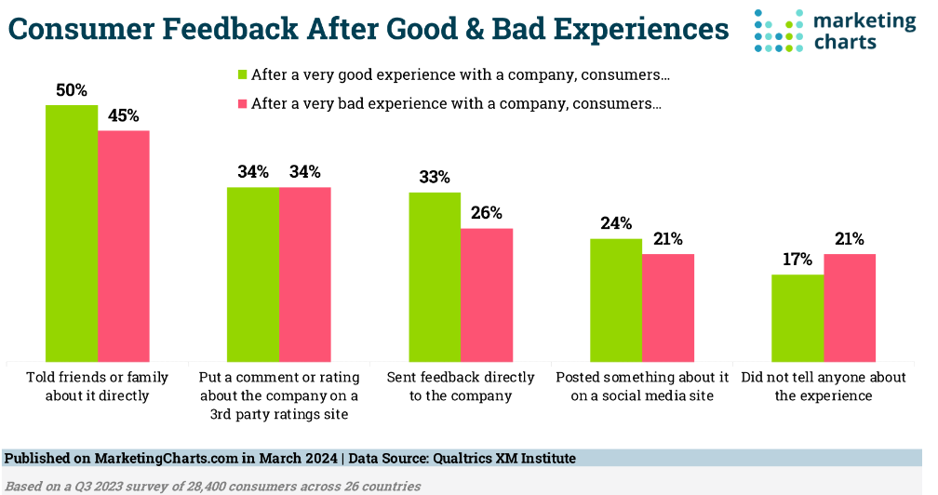
Consumer feedback

Slide 5
Know the regs & standards
The regulations and standards vary throughout the UK.
Know & understand the devolved regulations and standards or know how to reference them – this is vital to ensure compliance.
The Scottish Government Buildings Service Division:
  Domestic Technical Handbook April 2024
  Domestic Building Services Compliance Guide Feb 2023
  Non-Domestic Technical Handbook April 2024
  Non-Domestic Building Services Compliance Guide Feb 2023

Slide 6
Certification, accreditation & affiliation
Certifications – the credentials that show your skills or knowledge in a specific field or technology.
Accreditation – recognition, approval or accepting of something.
Affiliation – joining a professional body provides many benefits and assurances.
Displays professionalism and care.

Slide 7
Great customer service
Communication – the key to everything
Do what you say you are going to do
Communicate throughout the job
Explain the job, the tech, the changes in an easy-to-understand way, think of the learning styles & ensure understanding
Meet the customers' expectations and beyond.

Slide 8
Personalise the customer experience
Listen to the customer's needs & wants discuss, value their opinion
Create value
Meet your customers' expectations and beyond
Go the extra mile.

Slide 9
Customer feedback
Feedback helps us to know when we get it right & where we can improve.
Use customer feedback survey’s and thank them.
Act on feedback in a timely fashion & share the actions taken.
Testimonials – written, verbal or videos. A powerful way of showing successful customer outcomes.
Review websites – consider using them.

Slide 10
The power of social media
Add an active social media presence.
Facebook, TikTok, Instagram, Twitter, LinkedIn.
Share your work:
  Take photos & videos of jobs
  Tell the story of the job, the current set up and what is to be done,the challenges, the outcomes – start, middle, end.
  Use customer feedback, testimonials and evidence of improvements.
Keep posts regular and relevant – don’t spam.

Slide 11
Any questions?
  Thank you for your attention.
  suz.macgregor@snipef.org
  07484 421118
  Any technical Questions
  Contact George Todd or Scott Sanford
  12th September – Dundee

