Slide 1
Value Proposition Canvas - blank
12th August 2024

Slide 2
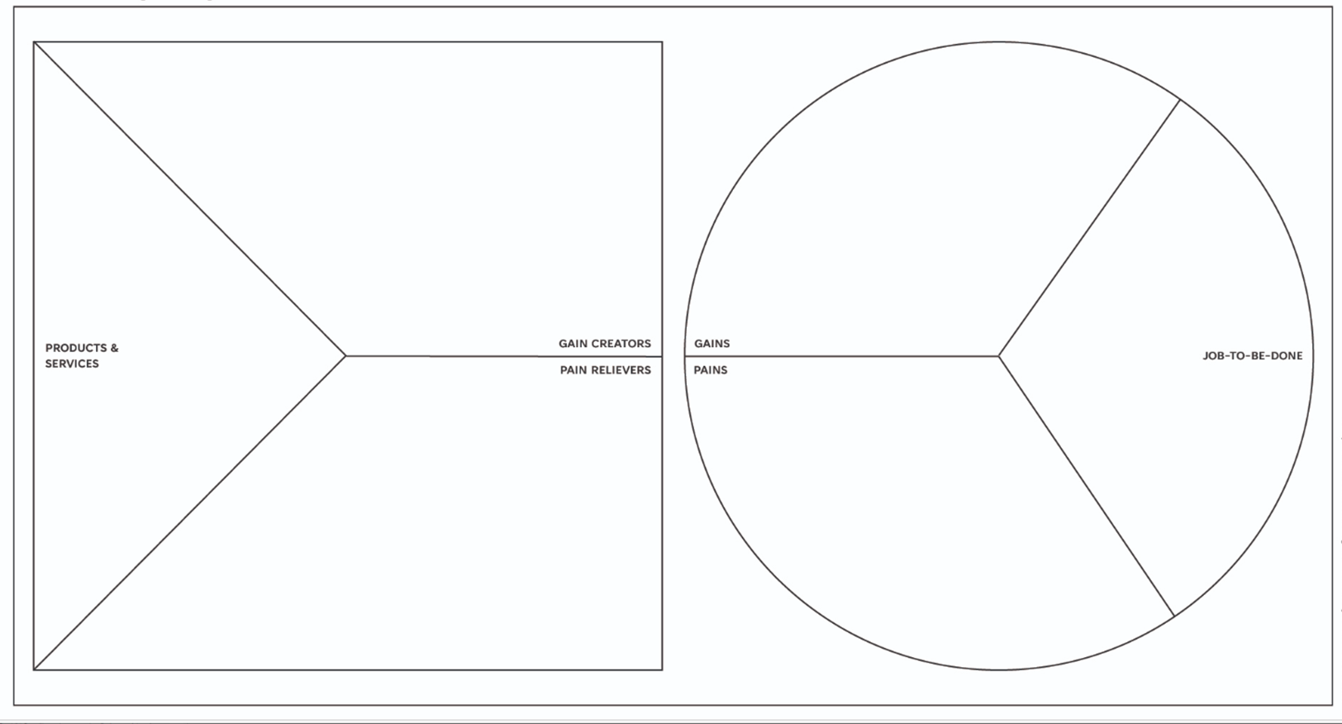

Slide 3
Value Proposition Canvas
Creates a bridge between your customer profile and the value you can create for them
VALUE MAP
CUSTOMER PROFILE
Gain creators
(can the gain be quantified?)
Customer gains
What are benefits or outcomes the customer wants to achieve?
Customer jobs
What is the customer trying to do?
Products and services
Customer pains
What are the bad outcomes or risks the customer wants to overcome?
Pain relievers
(can the pain relief be quantified?)

Slide 4
Customer Profile
Carry out Customer Discovery to understand…
Jobs – what tasks can the customer complete with your product or service, what function do they perform?
Pains -which customer problems does the customer have? What stops them getting their jobs done? What negative outcomes could they experience?
Gains – What outcomes do customers want to achieve? What benefits are they looking for? Questions to think about
CUSTOMER PROFILE
Customer gains
What are benefits or outcomes the customer wants to achieve?
Customer jobs
What is the customer trying to do?
Customer pains
What are the bad outcomes or risks the customer wants to overcome?

Slide 5
Thinking about Customer Profile
Jobs – what tasks can the customer complete with your product or service, what function do they perform?
Think about the context
What else are they thinking about?
Pains - which customer problems does the customer have? What stops them getting their jobs done? What negative outcomes could they experience? Questions to help think about pains:
What does your customer find too costly? (requires a lot of time or effort, costs too much money, it takes a lot of effort, etc.)
What makes him/her feel bad?
What are the current solutions that do not suit your customers?
What are the main challenges and problems your customer faces?
What negative social consequences does the customer face or fear to face? (Loss of reputation, credibility, trust, social status).
What risks does your customer fear? (financial, social, technical, etc.)
Gains – What outcomes do customers want to achieve? What benefits are they looking for? Think about required minimum gains expected gains, desired gains, unexpected gains. Questions to think about
What makes your customer happy? (Time, money, efforts, etc.)
What quality levels do they expect?
What results does your customer expect, and what can surpass these expectations?
What would simplify the work or life of your customer? (More services, lower cost, new features, etc.)
What are they looking for? (A smart design, guarantees, specific features, etc.)

Slide 6
Value map for your products and services
Products and services. List products, services, features. Focus on how these will help customers get their jobs done
Pain relievers. Elements that remove a frustration for the customer. How ease pains relevant to customers, so those mentioned in customer profile.
Gain creators. Elements that offer something new or improve user experience. Show how your product adds value to customers. How do they achieve their objectives?
Gain creators
(can the gain be quantified?)
Products and services
Pain relievers
(can the pain relief be quantified?)

Slide 7
Thinking about the value map
Products and services. List products, services, features. Focus on how these will help customers get their jobs done
Pain relievers. Elements that remove a frustration for the customer. How ease pains relevant to customers, so those mentioned in customer profile.
Does it fix the defects of existing solutions?
Does it remove the difficulties or problems that your customer faces?
Does it reduce the risks that your clients are afraid of?
Does it limit or eradicate common mistakes?
Gain creators. Elements that offer something new or improve user experience. Show how your product adds value to customers. How do they achieve their objectives?
Does your product/ service provide savings? (Regarding time, money, efforts, etc.)
Does it ensure the results that the customer expects?
Does it simplify the work or life of the customer?
Does it give something that your customer wants to get?
Does it give positive results that meet the criteria for success and failure of the customer?

Slide 8
Homework
Take VPC and prepare to pitch your proposition to others. Present both your VPC and a summary of your proposition
We will divide up so there are non-competing companies in smaller groups.
Think about:
What evidence do you have from your customers?
Can you quantify gains, or pain relievers, or at least be quite specific?
Can you prioritise?
How might the VPC influence your messaging?
Does it identify gaps you need to fill in your products or services?
What might customers be prepared to pay for?
Think like a customer. Focus on what customers need most.

Slide 9
Completing the VPC
Choose a customer segment. (Or more than one if you prefer)
Identify their jobs and prioritise them according to how important they are to your customer.
Identify pains and prioritise them.
Identify their gains and prioritise them.
Pick the top 3-5 most important pains and gains that relate to the most important jobs.
List all the benefits of your product or service.
List all pain relievers.
List of gain creators.
Pick 3-5 of the gain creators and pain relievers, that make the biggest difference to your customer.
Link the pain relievers, gain creators and product benefits to the pains, gains and jobs they solve.
Define how you’re better than the competition.
Create a value proposition statement that is clear and free of jargon and that builds trust with your customers.
Test your value proposition(s) with your customers. (We will test it with each other)

